Slide 1
Google Cap Stone: Bellabeat
How can a Wellness Company Play It Smart.

Slide 2
How do individuals use their smart devices?
Bellabeat
Marketing
Analysis of the Data
Bellabeat is a wellness company that sells smart devices to help individuals keep track of their health statistics.
The goal is to discover how the use of devices by looking at the data of what's collected from the clients.
Go into the data produced by fitbit to figure out the changes in the pattern of the individuals over time.

Slide 3
The Business Task: discover insights on use.
1. What are some trends in smart device usage?
The measurable activities of the group change over time increasing the good healthy habits and decreasing the negative unhealthy habits.

Slide 4
The Data: Fitbit Data is it useful?
Does the Data ROCC?
It's a first hand company acquiring computer data from devices.
The devices are computer programmable collections by first hand measurements on the characteristics making them reliable and original.
Health data is more timeless due to the nature of how evolution changes very slowly so 8 years ago shouldn’t be a reason to throw it out.

Slide 5
Data Analysis Phases
Clean the Data
Analyze the data
Create Visualizations
The Data was precleaned removing all the null values leaving every observation with a complete set of observations.
The data contained no outliers that are impossible
Following my intuition, I explored the data in time series graphs to see the changes of the individual overtime to solve the how do individual use devices.
Created individual vizulations and averaged by visualization groups to confirm the trends affect most individuals.

Slide 6
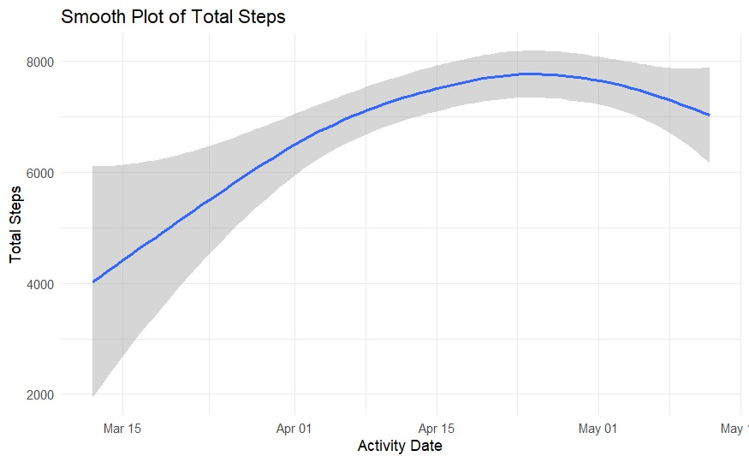
The Supporting Data:

Slide 7
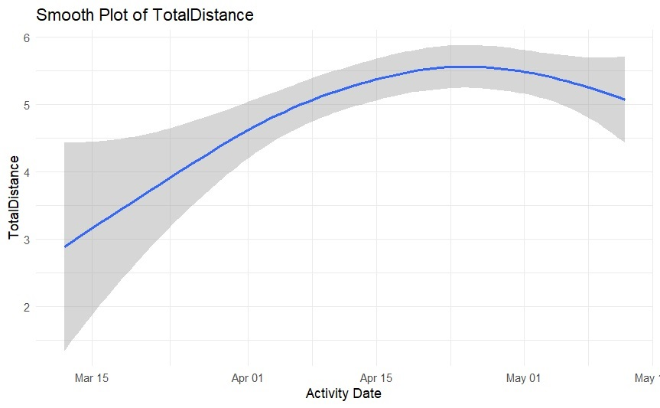
The Supporting Data:

Slide 8
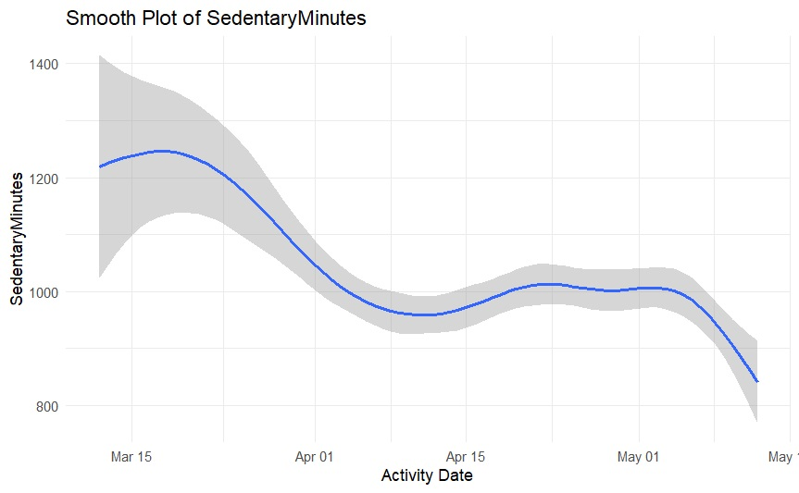
The Supporting Data:

Slide 9
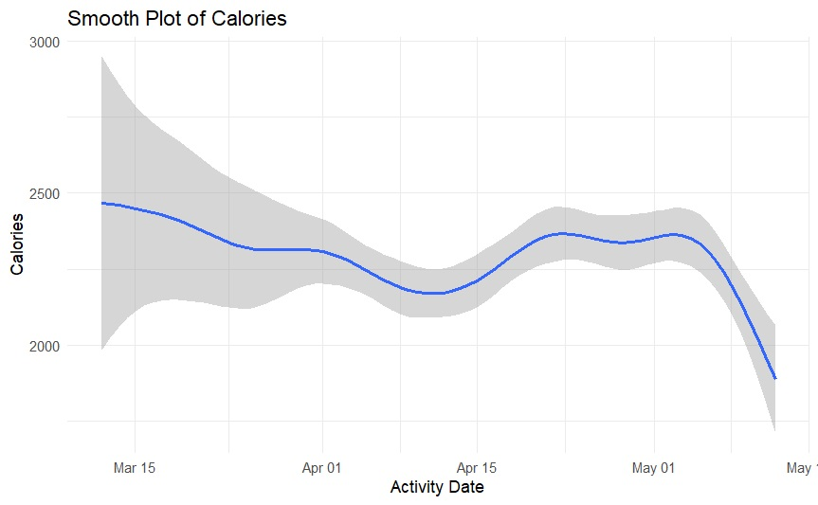
Supporting Data:

Slide 10
Advertise
The groups improvement in health across the multiple measurement show the impact of knowing your health.
The change of behavior towards the healthy habits

Slide 11
Show people the benefits of purchase

